Slide 1
Project Presentation
(Object detection using yolo algorthim)

Slide 2
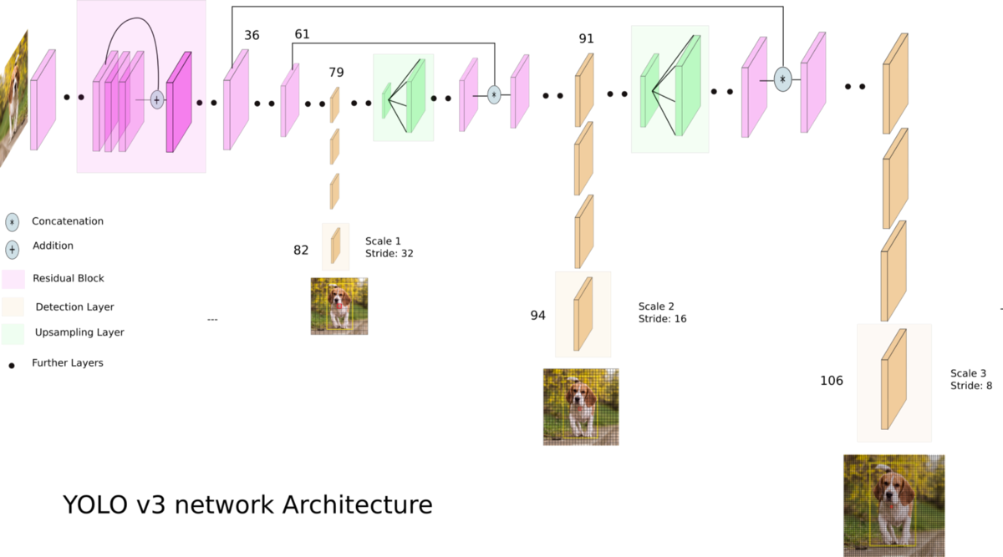
-Architecture used in the Paper

Slide 3
-Dataset details
Name of dataset: | Animals-10
Link of dataset: | https://www.kaggle.com/datasets/alessiocorrado99/animals10
The number of samples: | 26.2K sample
Dimension of images: | 320x320

Slide 4
-Implementation details
GitHub Link : | https://github.com/wahid205/Team-ID-20/blob/main/Project%20Code.ipynb

Slide 5
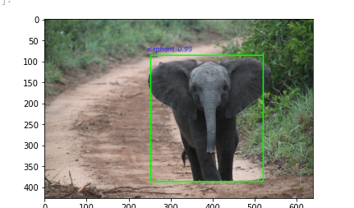
-Results and visualizations
newimge = cv2.cvtColor(img, cv2.COLOR_BGR2RGB)
plt.imshow(newimge)

